Slide 1
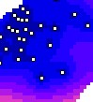




Introduction to uncertainty analysis in spatial environmental modelling
Kasia Sawicka and Gerard Heuvelink
Vienna, 24 April 2017
This project has received funding from the European Union’s Seventh Framework Programme for research, technological development and demonstration under grant agreement no 607000.
Notes:
Say who we are, from Wageningen, me postdoc, Gerard proffessor
Explain QUICS

Slide 2
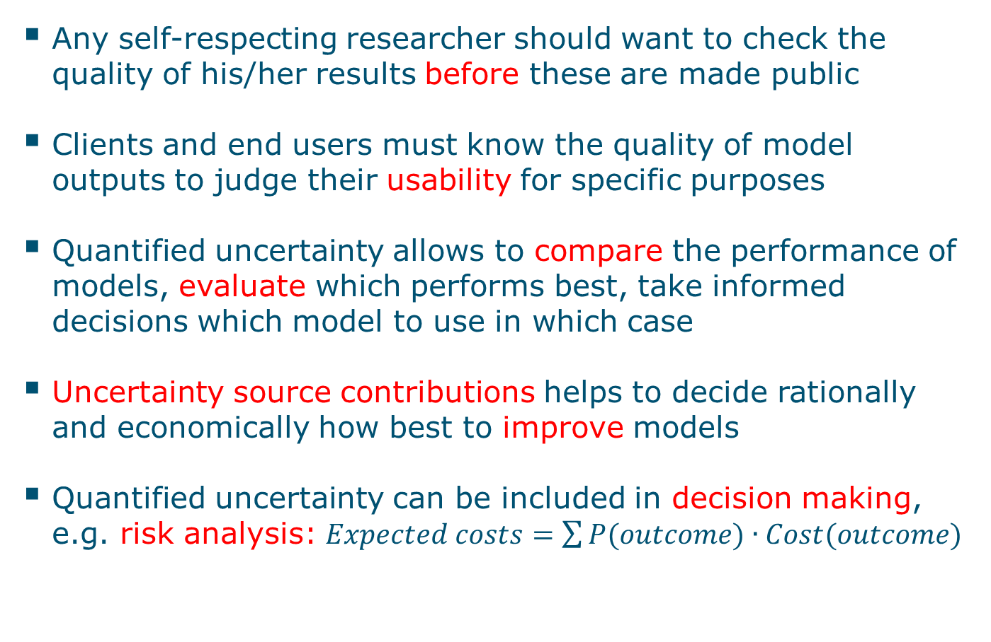
Why pay attention to uncertainty?
Any self-respecting researcher should want to check the quality of his/her results before these are made public
Clients and end users must know the quality of model outputs to judge their usability for specific purposes
Quantified uncertainty allows to compare the performance of models, evaluate which performs best, take informed decisions which model to use in which case
Uncertainty source contributions helps to decide rationally and economically how best to improve models
Quantified uncertainty can be included in decision making, e.g. risk analysis: $Expected costs=\sum{P(outcome)∙Cost(outcome)}$

Slide 3
Uncertainty propagation overview
Input ± U
Model (± U)
Output ± U
Model
output
Model
parameters
Input
data
Solution
method
Model
structure
Observ.
data
Data ± U
Notes:
In modelling, input data to the models and model parameters are encumbered with errors, for example a measurement error for the input data or the estimation error for parameters. On top of that we must be aware of the model structure error, caused for example by that we are not able to include all possible processes into one model.
When we run the model to obtain predictions these uncertainties propagate to the model outputs.

Slide 4
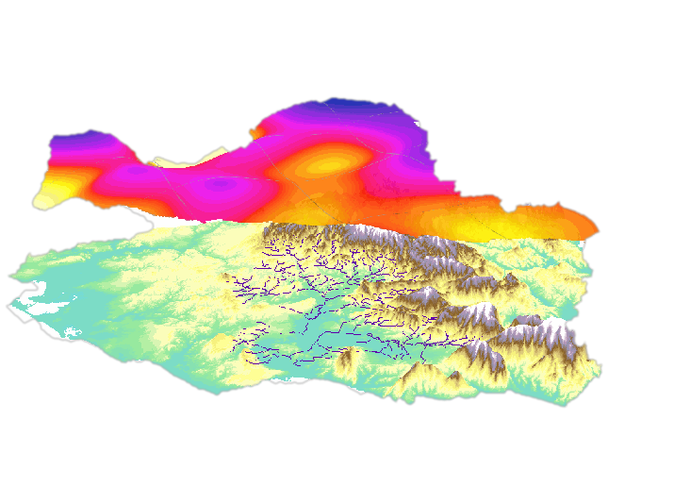
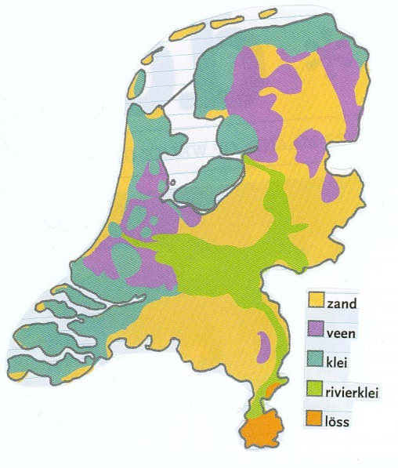
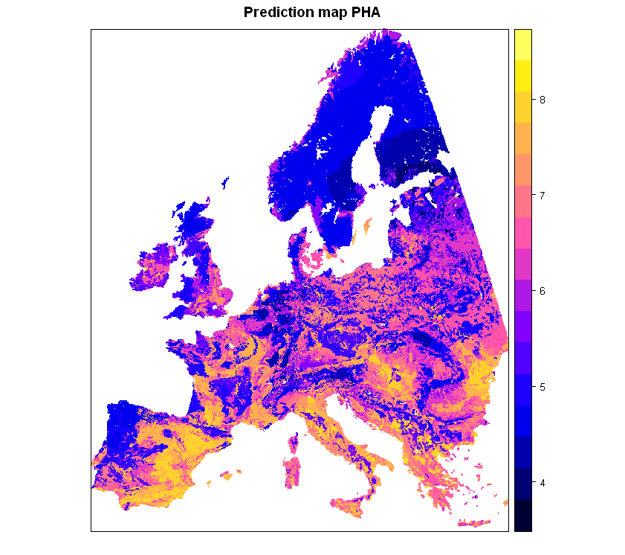

Environmental data vary in space
E.g. Rainfall
Categories like soil type
Environmental quality indicators like soil pH
Notes:
Environmental variables vary in space. Like rainfall, soil type, or other environmental quality indicators, for example soil pH.

Slide 5
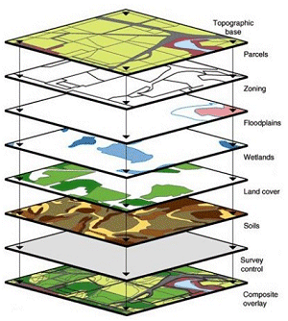
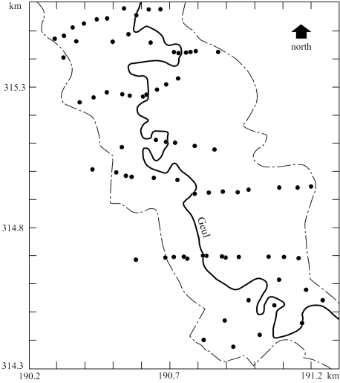
Deriving maps is encumbered with error
E.g. interpolation error or error associated with maps derived from other maps
input map A₁
input map A₂
input map A_{m}
Output map
Notes:
The space variation is often displayed by a mean of maps created using various interpolation techniques, for example kriging from point observations or deriving maps from other maps (like DEM and slope) and thus naturally encumbered with interpolation errors.

Slide 6
Fact of life: maps stored in the GIS database are rarely if ever error-free
Causes: generalisation, digitisation, measurement, classification and interpolation errors
Consequence: errors will propagate through GIS operations and spatial models
Key research question: given the errors in the inputs to the GIS operation, how large are the errors in the output?

Slide 7
Uncertainty propagation analysis involves three steps:
DEFINITION of a (statistical) uncertainty model for variables of interest
IDENTIFICATION of the uncertainty model (estimate its parameters)
Perform the actual UNCERTAINTY PROPAGATION ANALYSIS

Slide 8
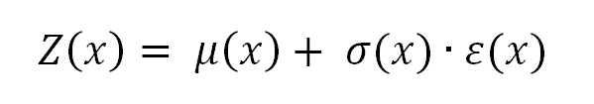
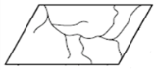

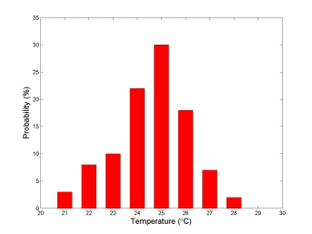
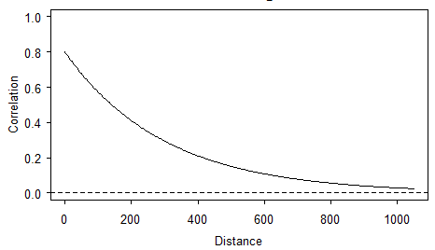
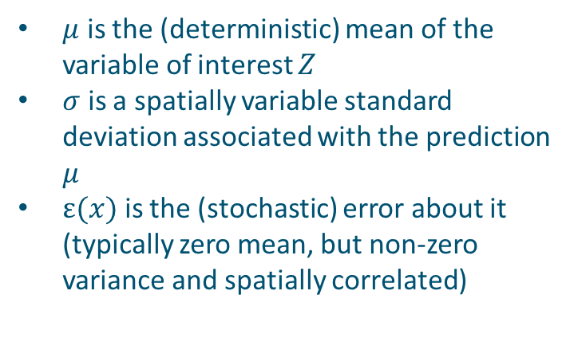
DEFINE and IDENTIFY a (statistical) uncertainty model
DEFINITION
IDENTIFICATION
Marginal pdf at each location (both its shape and parameters)
Spatial correlation (correlogram or semivariogram)
Cross-correlation with other uncertain inputs
Acf
ρ_{xy}(Z,Z)
range
$μ$ is the (deterministic) mean of the variable of interest $Z$
$σ$ is a spatially variable standard deviation associated with the prediction $μ$
$ε(x)$ is the (stochastic) error about it (typically zero mean, but non-zero variance and spatially correlated)
Notes:
Identify uncertainty model
Measurement error from instrument and lab specifications, or by taking replicates (always let laboratories analyse duplicates, without telling them!)
Sampling error using sampling theory from statistics (e.g. standard error of the mean, confidence intervals)
Use of ground truth verification data (e.g. control points)
Interpolation error using geostatistics (kriging)
Errors in transfer functions such as regression: R-square
Classification error using multivariate statistics (e.g. maximum likelihood classification remote sensing imagery)
Expert judgement or Expert elicitation (last resort?)

Slide 9
Performing the actual UNCERTAINTY PROPAGATION ANALYSIS
Taylor series approximation method
Monte Carlo method

Slide 10
Monte Carlo method
Introduce by means of an example

Slide 11
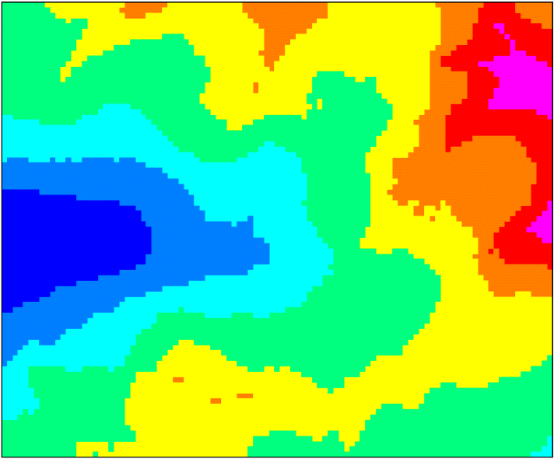
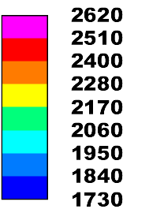
Example: computing slope from DEM for a 2 by 2.5 area in the Austrian Alps

Slide 12
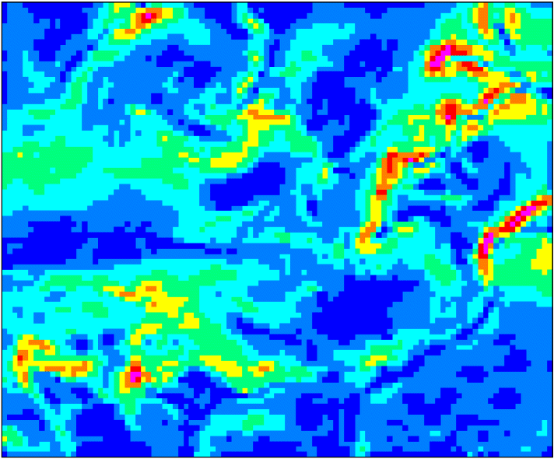
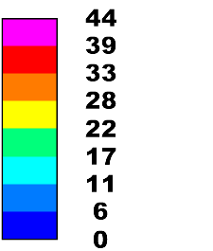
Slope map computed from the DEM (percent):

Slide 13
Now let the uncertainty about the elevation be ± 10 meter

Slide 14
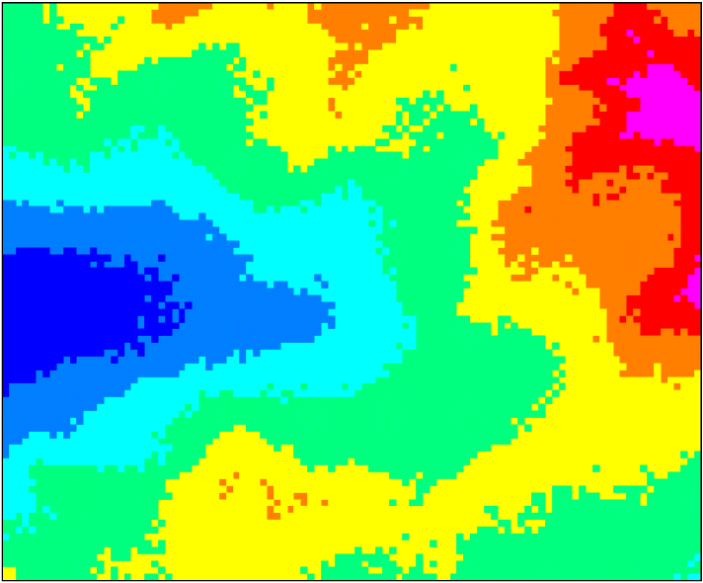
Realisations of uncertain DEM:

Slide 15
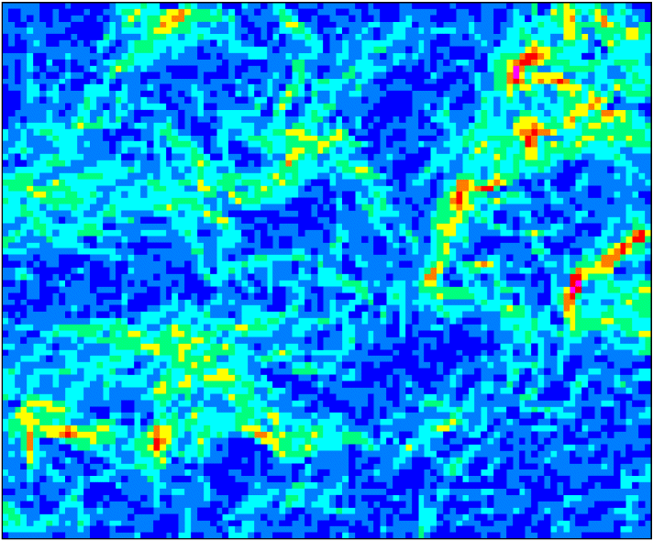
Corresponding slope maps:

Slide 16
Histograms capture uncertainty in slope:

Slide 17
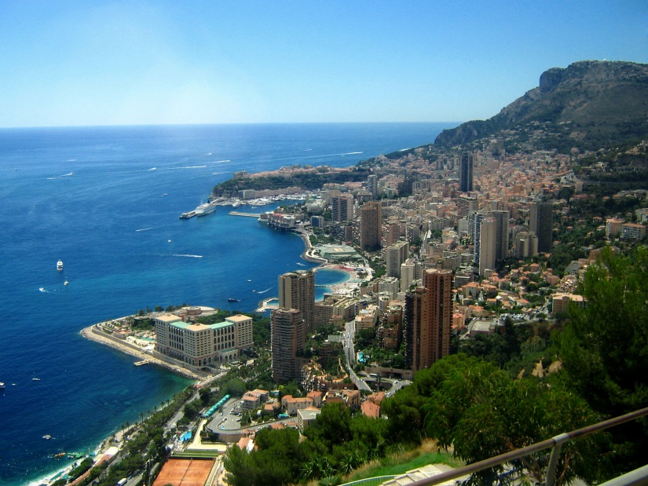

Monte Carlo algorithm:
Repeat N times (N ≥ 100):
Simulate a realisation from the probability distribution of the uncertain inputs using a pseudo-random number generator
Run the model with these inputs and store the result
Analyse the N model outputs by computing summary statistics such as the mean and standard deviation (the latter is a measure of the output uncertainty)

Slide 18
Performing the actual UNCERTAINTY PROPAGATION ANALYSIS
Taylor series approximation method
Monte Carlo method
Advantages Monte Carlo method:
Yields the full output pdf, not only the mean and variance
Works with any model
Easy to implement

Slide 19
Monte Carlo method with spatial inputs
Requires that we simulate from the probability distribution of a spatially distributed variable
Can be done with spatial stochastic simulation: instead of kriging, which produces the most likely value (conditional expectation), we generate a possible reality, by simulating from the probability distribution of the spatial variable, using a pseudo-random number generator
Spatial correlations are taken into account

Slide 20
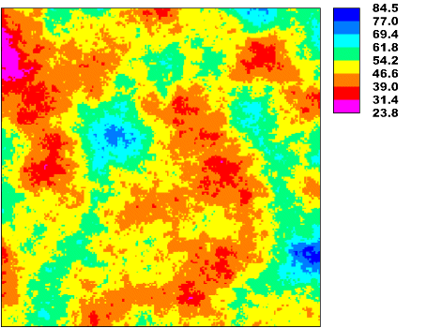
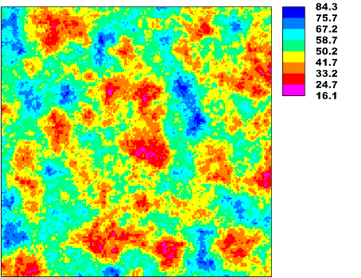
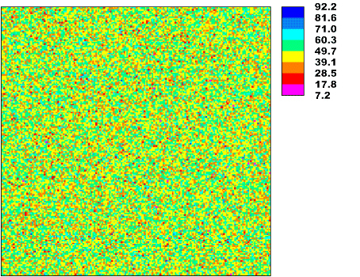
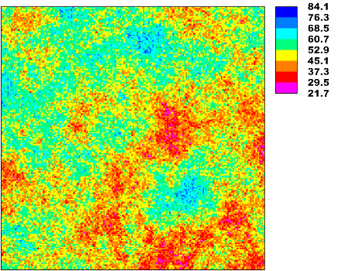
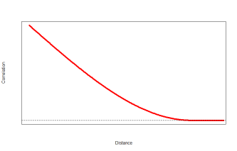
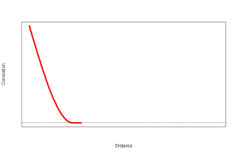
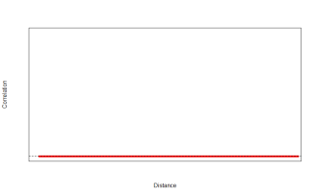
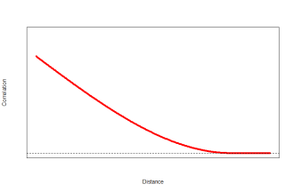
Why is it important to include spatial correlation?
1.0
1.0
1.0
0.8
Correlation
Correlation
Correlation
Correlation
0
Distance
Distance
Distance
Distance
The spatial pattern of the generated realizations depends on the degree of spatial autocorrelation.
Important for neighbourhood or global operations (opposite to point operations).

Slide 21
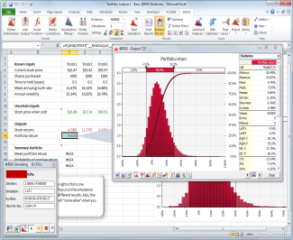
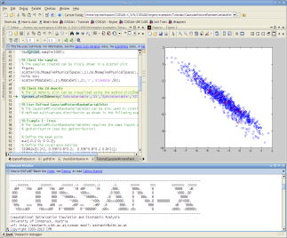
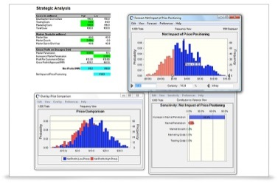
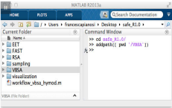
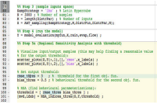
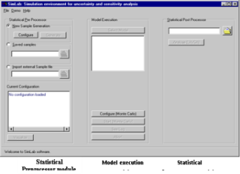
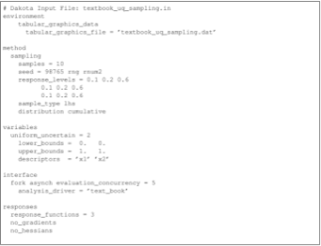
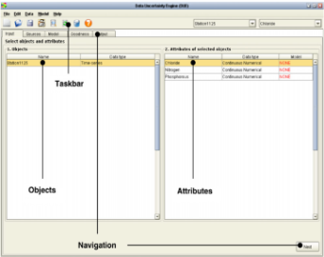
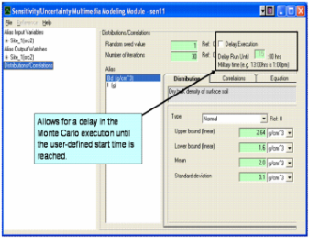
R package spup - motivation
@RISK
COSSAN
Crystall Ball
SAFE
UQLab
UNCSIM
UNCSAM
UCODE
TIME
R packages:
propagate
FME
mcmcse
ArArRedux
betaper
UncerIn2
usdm
sensitivity
- and others...
OpenTURNS
OSTRICH
PEST
PSUADE
SimLAB
DAKOTA
DUE
FRAMES

Slide 22
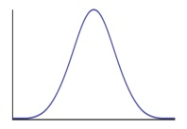



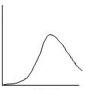
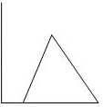
R package spup – underlying methodology
Monte Carlo approach principle
Variable 1
Sampling
Model run (e.g.
Output = Var1 x Var2)
Variable 2
Sampling
c(10, 14, 3, 16, ....)
R
D
R
P
V
22

Slide 23

R package spup - functionality
R
D
R
P
V
Import data and objects and define UM
Monte Carlo sampling techniques
Model call and simulations
Visualization of results
23

Slide 24
Computer exercise – calculating slope from DEM
Analyse how uncertainty in DEM map of Zlatibor region in Serbia propagates to slope calculations
Check how uncertain the DEM and slope map is, and where in Zlatibor it is most uncertain
Identify areas in Zlatibor for which you are 90% certain that the soil is in risk of serious erosion
DEM
Slope

Slide 25

Computer exercise – calculating slope from DEM
Analyse how uncertainty in DEM map of Zlatibor region in Serbia propagates to slope calculations
Check how uncertain the DEM and slope map is, and where in Zlatibor it is most uncertain
Identify areas in Zlatibor for which you are 90% certain that the soil is in risk of serious erosion
https://github.com/
ksawicka
‘SUPA_EGU2017’ repository
Folder ‘install’:
Folder ‘practical’:
Required:
R >= v.3.3.3
Packages:
spup
sp
gstat
GGally
gridExtra
purrr
magrittr
Data:
mean DEM:
dem30m.RData
sd DEM:
dem30m.RData
R script:
- DEM_exercise.R
PDF tutorial:
- DEM_excercise.pdf

